Slide 1
CATALYSIS IN SURFACE CHEMISTRY
Preparation of Oxygen from potassium chlorate in presence of Manganese dioxide as a catalyst.
2KClO₃-> 2KCl + 3O₂(at 653K-873K)
2KClO₃-> 2KCl + 3O₂ (at 473K-633K in presence of MnO₂ as catalyst)

Slide 2
Catalysis is the increase in the rate of a chemical reaction due to the participation of an additional substance called a catalyst.
In general, the reactions occur faster with a catalyst because they require less activation energy. In catalyzed mechanisms, the catalyst usually reacts to form a temporary intermediate which then regenerates the original catalyst in a cyclic process.

Slide 3
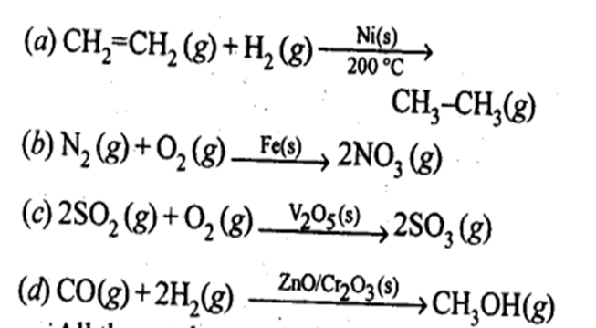

Slide 5
TYPES OF CATALYSIS
HOMOGENEOUS
HETEROGENEOUS
Homogeneous catalysis refers to catalytic reactions where the catalyst is in the same phase as the reactants. Homogeneous catalysis applies to reactions in the gas phase and even in solids.
Heterogeneous catalysis refers to the form of catalysis where the phase of the catalyst differs from that of the reactants. Phase here refers not only to solid, liquid, vs gas, but also immiscible liquids, e.g. oil and water.

Slide 10
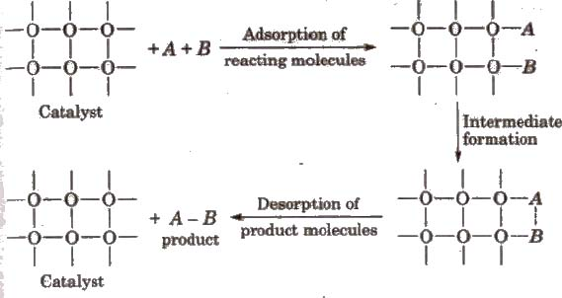

Slide 14
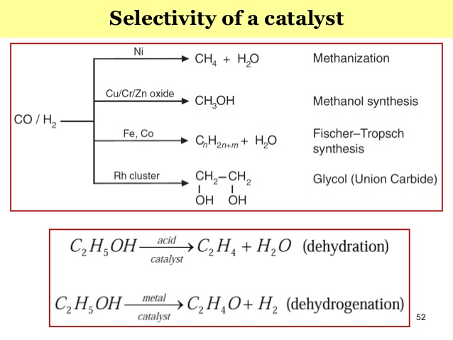

Slide 16
ZSM-5 IS SHAPE SELECTIVE MATERIAL –used converting alcohol to gasoline by dehydrating them.

Slide 21
MECHANISM OF ENZYME CATALYSIS

Slide 22
